Slide 1

Faculty of Computer Science & IT
Introduction to Artificial Intelligence

Slide 2
Movie Revenue Prediction
The idea of the project, in general, is to predict movie profits based on
pre-recorded data for other films through the use of a linear
regression algorithm

Slide 3
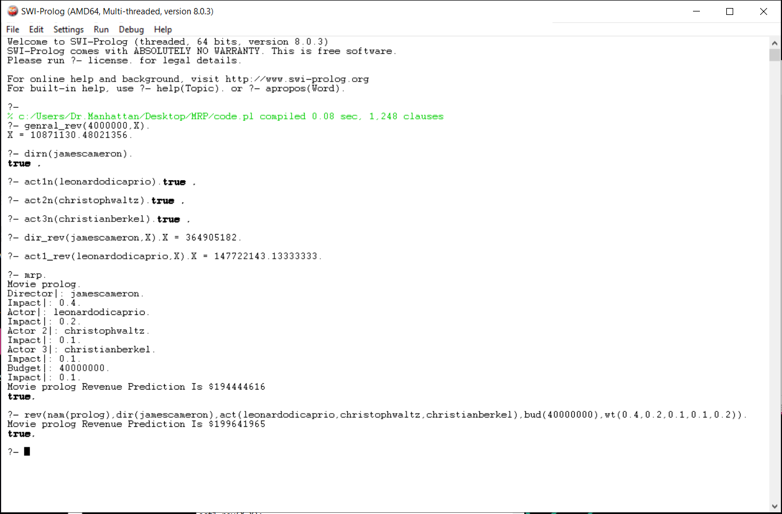

Slide 4
genral_rev : General prediction by budget .
dirn ,act1n , act2n ,act3n :Check if the name of the director, actors is exited before or not.
dir_rev : Special prediction by director
act1_rev Special prediction by actor
mrp, rev do the same but in a different format input by predicting the movie revenue by director, actors, budget by Customize every one impact (weight).

Slide 5
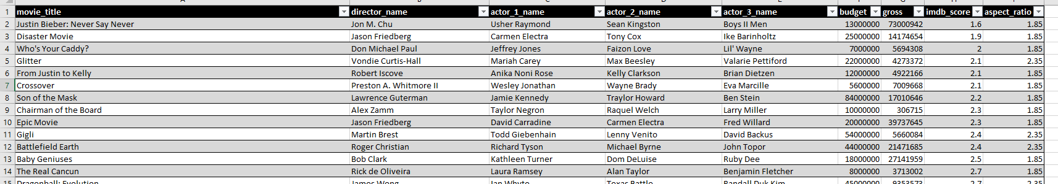
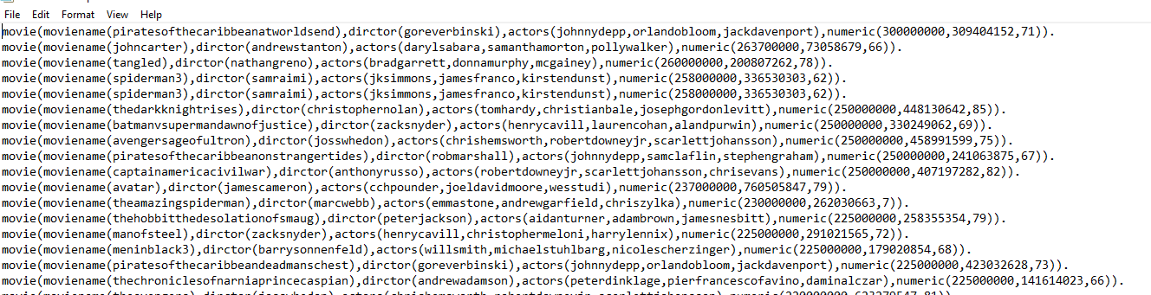
Used data

Slide 6
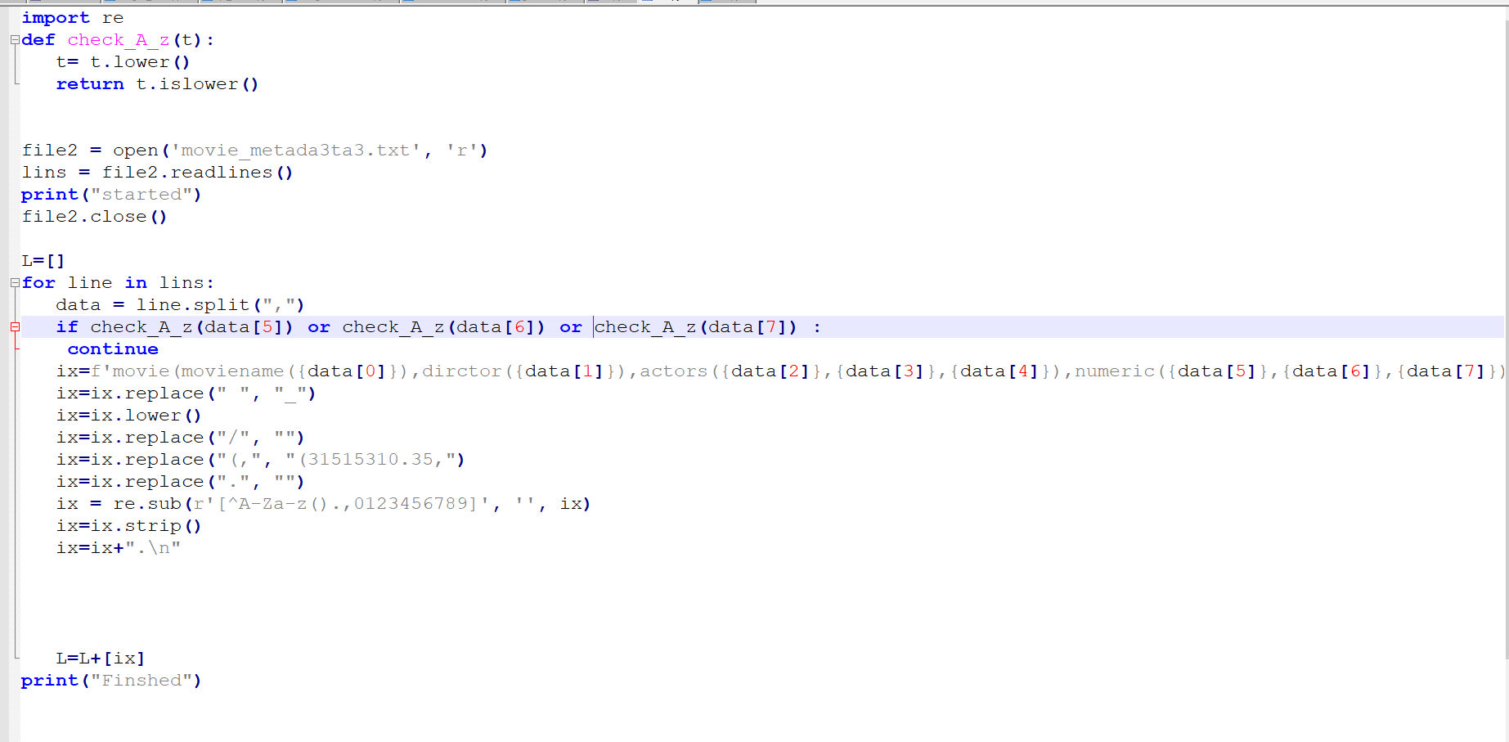
Data engineering code

Slide 7
Thanks

